Slide 1
Introduction to Matrices and Linear Regression Models in Matrix Terms

Slide 2
What is a matrix?
An r×c matrix is a rectangular array of symbols or numbers arranged in r rows and c columns.
A matrix is almost always denoted by a single capital letter in boldface type.

Slide 3
Definition of a vector and a scalar
A column vector is an r×1 matrix, that is, a matrix with only one column.
A row vector is an 1×c matrix, that is, a matrix with only one row.
A 1×1 “matrix” is called a scalar, but it’s just an ordinary number, such as 4 or σ².

Slide 4
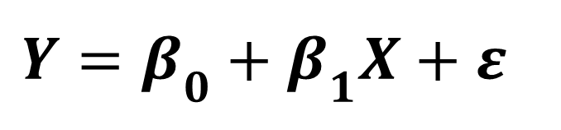
Simple OLS regression equation
$$Y=β_{0}+β_{1}X+ε$$
for i = 1,…, n

Slide 5
Simple regression in matrix notation

Slide 6
Matrix addition
The Xβ+ε in the regression equation is an example of matrix addition.
Simply add the corresponding elements of the two matrices.
For example, add the entry in the first row, first column of the first matrix with the entry in the first row, first column of the second matrix, and so on.
Two matrices can be added together only if they have the same number of rows and columns.
Same rules for matrix subtraction.

Slide 7
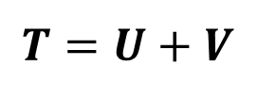
Matrix addition
$$T=U+V$$
For example:

Slide 8
Scalar by matrix multiplication
Just multiply each element of the matrix by the scalar.
For example:

Slide 9
Matrix multiplication
The Xβ in the regression function is an example of matrix multiplication.
Two matrices can be multiplied together iff the number of columns of the first matrix equals the number of rows of the second matrix.
Otherwise, matrix multiplication is impossible!
The number of rows of the resulting matrix equals the number of rows of the first matrix.
The number of columns of the resulting matrix equals the number of columns of the second matrix.
Notes:
3x8 matrix multiplied by an 8x6 matrix: 8=8, so multiplication is possible. Resulting matrix: 3 rows, 6 columns.

Slide 10
Matrix multiplication
If A is a 2×3 matrix and B is a 3×5 matrix then matrix multiplication AB is possible. The resulting matrix C = AB has 2 rows and 5 columns.
Is the matrix multiplication BA possible?
That is, is matrix multiplication commutative?
If X is an n×p matrix and β is a p×1 column vector, then Xβ is a ______.
Notes:
Nx1 column matrix

Slide 11
Matrix multiplication
The entry in the i^{th} row and j^{th} column of Q is the inner product (sum of the element-by-element products) of the i^{th} row of R with the j^{th} column of S.
R is a 2 x 3 matrix; S is a 3 x 4 matrix. Q = RS is a 2 x 4 matrix.
Q = RS =

Slide 12
The Xβ Multiplication in Simple Regression
Xβ
Recall: n x 2 matrix multiplied by a 2 x 1 matrix will yield an n x 1 matrix
Notes:
n x 2 matrix multiplied by a 2 x 1 matrix. The result will be an n x 1 matrix.

Slide 13
The Xβ+ε addition in simple OLS regression
n x 1 + n x 1 = n x 1 matrix

Slide 14
Multiple regression function in matrix notation
Predictor
1st 2nd 3rd
n x 1 n x 4 4 x 1 n x 1

Slide 15
The transpose of a matrix
The transpose of a matrix M is a matrix, denoted M' or M^{T}, whose rows are the columns of M and whose columns are the rows of M, in the same original order.

Slide 16
The X'X matrix for simple OLS regression
2 x n n x 2
X’X =
Notes:
2 x n matrix multiplied by n x 2 matrix = 2 x 2 matrix

Slide 17
Definition of the identity matrix
The (square) n×n identity matrix, denoted I_{n}, is a matrix with 1’s on the diagonal and 0’s elsewhere.
The identity matrix plays the same role as the number 1 in ordinary arithmetic in matrix multiplication.

Slide 18
The inverse of a matrix
The inverse A⁻¹ of a square matrix A is the unique matrix such that …
Notes:
A matrix is a square matrix if it has the same number of rows and columns
The inverse is only defined for square matrices
Not all square matrices have inverses, and no matrix may have more than one inverse
If A⁻¹ is the inverse of A, then A is the inverse of A⁻¹
A square matrix that doesn’t have an inverse is called a singular matrix

Slide 19
Least Squares Parameter Estimates

Slide 20
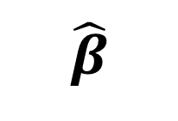
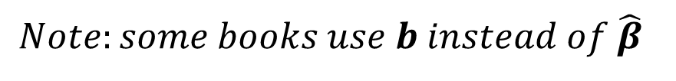
Least squares estimates
The p×1 vector containing the estimates of the p parameters can be shown to equal:
$$\hat{β}$$
(X’X)⁻¹ X’Y
$$Note:some books use b instead of \hat{β}$$
Notes:
Y = BX.

Slide 21

OLS Estimates in Simple Linear Regression
Find X'X.
Recall that…
age vocab age*vocab age²
4 20 80 16
5 30 150 25
6 40 240 36
7 45 315 49
8 50 400 64
9 55 495 81
10 60 600 100
---- ----- ------- -------
SUMS
49 300 2280 371
X’X
$$\hat{β}$$
(X’X)⁻¹ X’Y
Notes:
Remember the age and vocabulary example. Here age is measured in years and vocabulary in 100’s of words.

Slide 22
The Details
X’X

Slide 23
OLS Estimates in simple linear regression
Find inverse of X'X.
It’s very messy to determine inverses by hand. We use computers to do so. You can do so with MATLAB (a software package you will use next semester) or even online: http://www.bluebit.gr/matrix-calculator/.
(X’X)

Slide 24

Least Squares Estimates in Simple Regression
2 x n n x 1 => 2 x 1
Find X'Y.
age vocab age*vocab age²
4 20 80 16
5 30 150 25
6 40 240 36
7 45 315 49
8 50 400 64
9 55 495 81
10 60 600 100
---- ----- ------- -------
49 300 2280 371
$$\hat{β}$$

Slide 25
OLS estimates in simple linear regression
Β = (X’X)⁻¹ X’Y
So, the regression equation is:
Vocabulary = - 2.10 + 7.08 Age

Slide 26
Linear dependence
The columns of the matrix: A =
are linearly dependent, since (at least) one of the columns can be written as a linear combination of another.
If none of the columns can be written as a linear combination of another, then we say the columns are linearly independent.

Slide 27
Linear dependence is not always obvious
Formally, the columns s₁, s₂, …, s_{n} of an n×n matrix are linearly dependent if there are constants a₁, a₂, …, a_{n}, not all 0, such that:

Slide 28
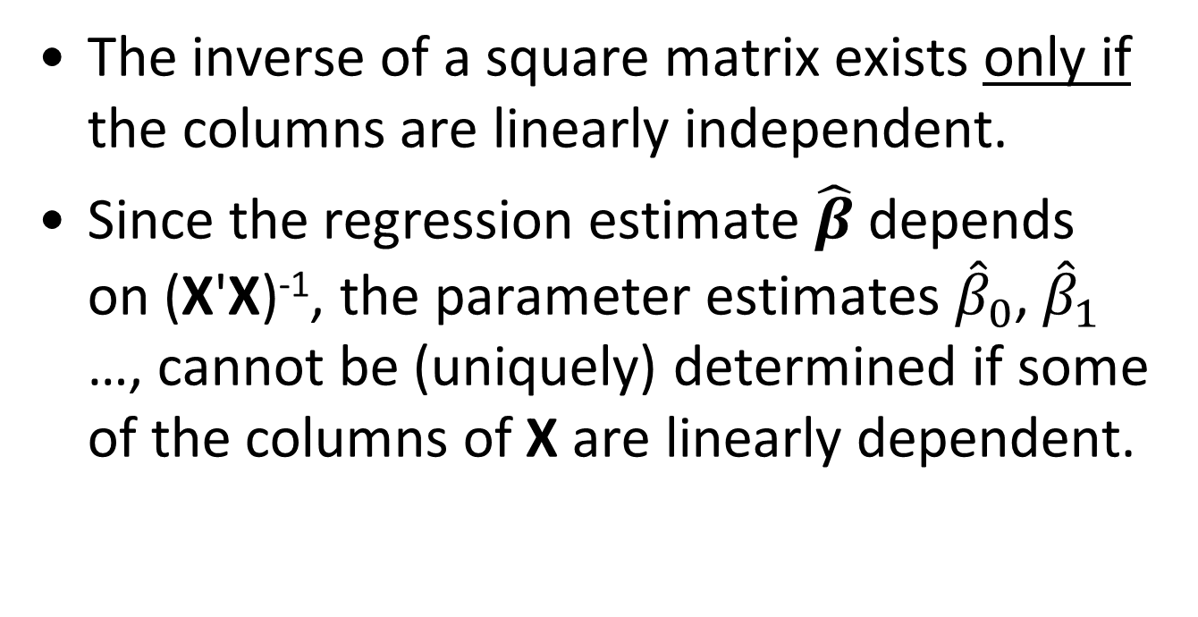
Implications of linear dependence on regression
The inverse of a square matrix exists only if the columns are linearly independent.
Since the regression estimate $\hat{β}$ depends on (X'X)⁻¹, the parameter estimates ${\hat{β}}_{0}$, ${\hat{β}}_{1}$ …, cannot be (uniquely) determined if some of the columns of X are linearly dependent.

Slide 29
The take-home message…
If the columns of the X matrix are exactly or nearly linearly dependent (that is, if two or more of your explanatory variables are very strongly correlated), you will have problems estimating the regression function.
This is the concept of MULTICOLLINEARITY in matrix terms!

Slide 30
Fitted values and residuals

Slide 31
Fitted (or predicted) values

Slide 32
Fitted values
Recall that:
The vector of fitted (or predicted) values
is sometimes represented as a function of the hat matrix H
That is:

Slide 33
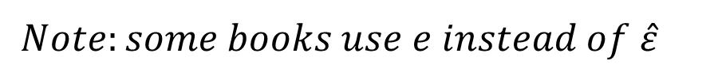
The predicted (estimated) residual vector
for i = 1,…, n
$$Note:some books use e instead of \hat{ε}$$

Slide 34
The Residual Vector Written Differently

Slide 35
Sum of Squares

Slide 36
Sum of squares
In general, if you multiply any vector t by its transpose t^{T}, (or rather, multiply t^{T} by t) you get a sum of squares.
So in that case, if you pre-multiply residual vector by its transpose , you’ll get residual sum of squares:

Slide 37
Total sum of squares
In the last deck of slides, we saw that:
In matrix notation, we can write:
where J is a (square) n×n matrix containing all 1’s.
Notes:
Recall that SST = SSR + SS

Slide 38
Model assumptions

Slide 39
Error term assumptions
Recall that the error terms ε_{i} are:
normally distributed (with mean 0)
with equal variances σ²
independent
Now, let’s interpret this into matrix and vector language
Notes:
From Wikipedia: A statistical error is the amount by which an observation differs from its expected value, the latter being based on the whole population from which the statistical unit was chosen randomly. For example, if the mean height in a population of 21-year-old men is 1.75 meters, and one randomly chosen man is 1.80 meters tall, then the "error" is 0.05 meters; if the randomly chosen man is 1.70 meters tall, then the "error" is −0.05 meters. The expected value, being the mean of the entire population, is typically unobservable, and hence the statistical error cannot be observed either.
A residual (or fitting error), on the other hand, is an observable estimate of the unobservable statistical error. Consider the previous example with men's heights and suppose we have a random sample of n people. The sample mean could serve as a good estimator of the population mean. Then we have:
The difference between the height of each man in the sample and the unobservable population mean is a statistical error, whereas
The difference between the height of each man in the sample and the observable sample mean is a residual.
Note that the sum of the residuals within a random sample is necessarily zero, and thus the residuals are necessarily not independent. The statistical errors on the other hand are independent, and their sum within the random sample is almost surely not zero.
One can standardize statistical errors (especially of a normal distribution) in a z-score (or "standard score"), and standardize residuals in a t-statistic, or more generally studentized residuals.

Slide 40
Errors as a random vector
The n×1 random error term vector, denoted as ε, is:

Slide 41
Expected value of the random error term vector
The n×1 mean error term vector, denoted as E(ε), is:

Slide 42
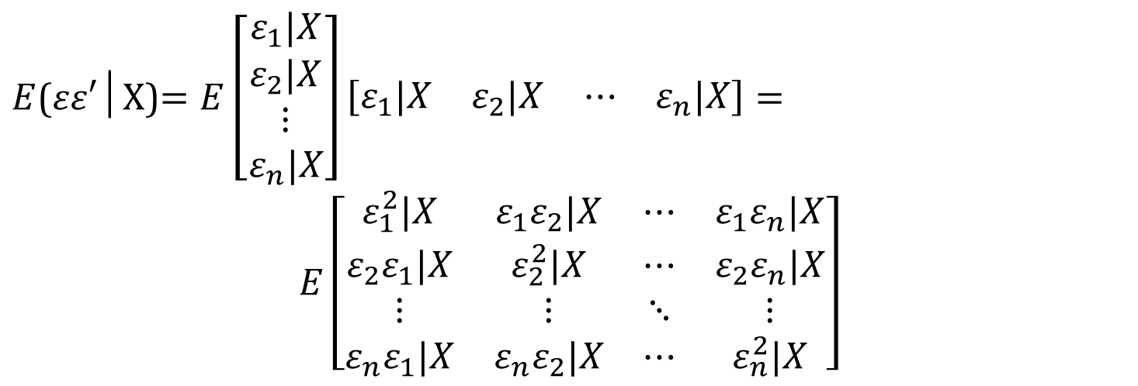
Variance of the random error term vector
Recall from the previous lecture that the variance of the errors is assumed to be σ². That is, variance of errors is constant, and doesn’t vary with X - i.e., the assumptions of homoscedasticity and independence of errors (i.e., no autocorrelation) hold.
Now let’s define the variance-covariance matrix of errors as E(εε’|X):

Slide 43
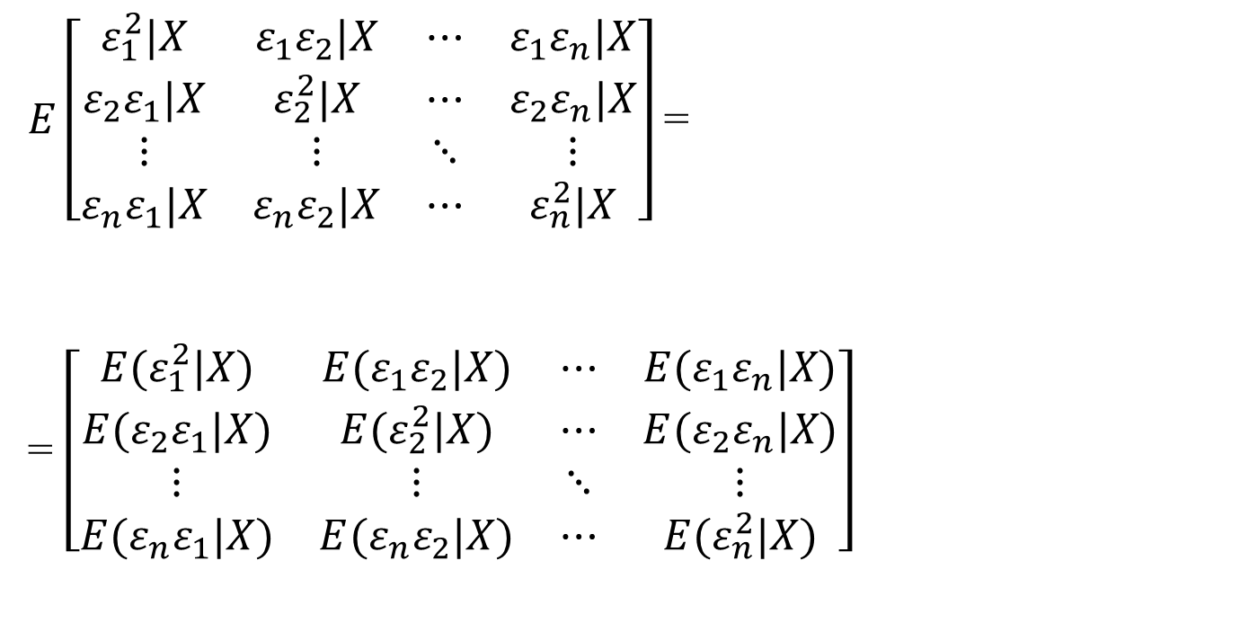
Variance of the random error term vector (cont’d)
Recall that E(ε) = μ = 0.
That is, the true average value of the errors is 0.
By definition,
V(ε) = E(ε – μ)² = σ².
But, since μ = 0,
σ² = E(ε – μ)² = E(ε)².

Slide 44
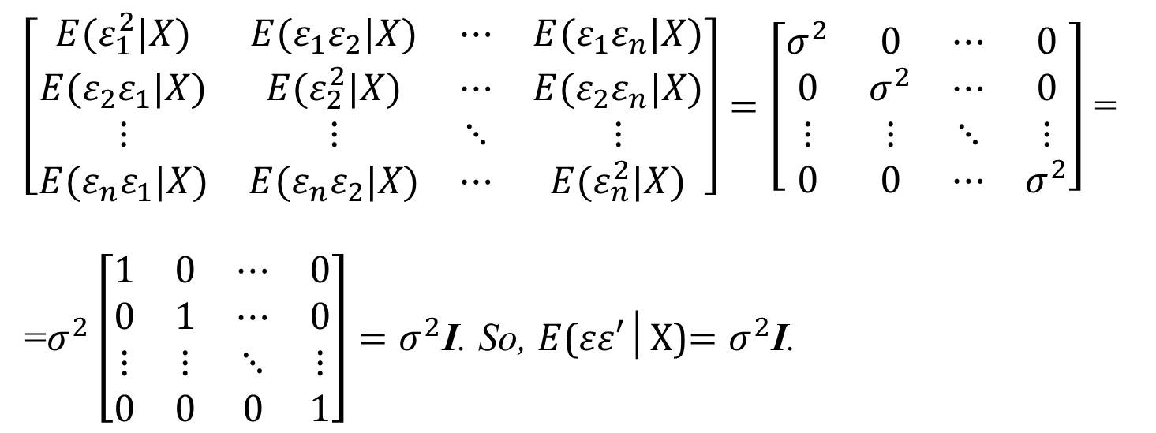
Variance of the random error term vector (cont’d)
If we have homoscedasticity, then regardless of the values of predictors X, E(ε_{i})² = σ² for all i. So all terms on the main diagonal can be replaced by σ².
Also, if observations are independent (not autocorrelated), then the covariance terms E(ε_{i} ε_{j}|X) should be 0 for all i and j. That is, the error of one observation should be completely independent of the error of another observation, even if their predictors X have similar values.
(This is a regression assumption)

Slide 45
The general linear regression model
Putting the regression function and assumptions all together, we get:
where:
Y is an n x 1 vector of response (dependent variable) values
X is an n x k matrix of predictor values
β is an k x 1 vector of k unknown parameters
ε is an n x 1 vector of independent, normal error terms with mean 0 and (equal) variance σ²I.

Slide 46
Suggested Reading (over the winter break):
More about matrices and OLS in matrix notation: https://files.nyu.edu/mrg217/public/ols_matrix.pdf
and http://www.unc.edu/~nielsen/soci709/m4/m4.pdf
Determinants: http://www.es.ucsc.edu/~eart111/lecture12.pdf
Eigenvalues/Eigenvectors: http://ceee.rice.edu/Books/LA/eigen/

